Slide 1
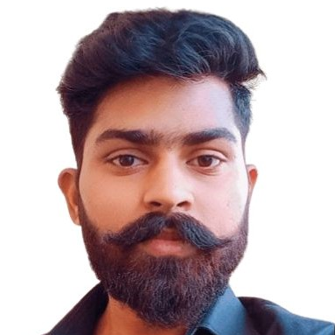



Shri Prakash Yadav
Bachelor of Engineering
Computer Science Engineering:2018-2022
Analyst/Software Engineer
Skills
Java 8 /J2EE | Java Basics, OOPS, Generics, Collections, Arrays, Loops, Lambda Exp, Stream API Junit, Mockito, Servlets
Spring core | IOC & Dependency Injection, Autowire
Spring REST | REST controllers, Implementation of GET, POST, PUT & DELETE, Bean Validation & Exception Handling, Testing Services, Controller & Repository layer
Spring Data JPA | Implement DAO layer using spring Data repositories, Transaction Management
Spring Boot Microservices | Spring Boot Starters, annotations, Messaging Service, Sync/Async comms, Swagger API documents
Spring Cloud | Eureka, Netflix Hystrix, Netflix Zuul & Config Server
Angular | Components, Services, Modules, Routing, Forms & Validation, Testing using Jasmine & Karma
Database | MongoDB No Sql Basics My SQL RDS Basics
UI Tech | HTML 5 & CSS 3,JavaScript, ES6 & TypeScript Reusable templates, Optimized UI Designed
Tools | Git, Postman, Maven, IDE
Add On skills | Communications, Team management. Peer learning
Mumbai
Shri-Prakash.yadav@Capgemini.com
+918058915391
A4
Full Stack Developer
Hands on experience in creating microservices with Springboot, Spring Security, Spring Cloud API Gateway, Eureka server, load balancing,
Proficient in creating Single page Web Application in Angular with Authentication with route guards, Angular reactive forms, angular routing.
Hands on experience in implementing microservice architecture with Angular & spring boot
Experience in creating documentation with Java docs and swagger and in unit testing using Junit, Mockito including code quality compliance using Sonar cube
Development experience in creating docker images and pushing to Docker Hub
Pharmacy Management System
Completed end to end case study of Pharmacy Management System along with JWT authentication, Swagger and payment testing using Paytm Gateway, responsive UI with Bootstrap and Angular Material and Angular used for user interface.
Developed application named MEDICARE for making a comfort for the doctors to buy the medicines from the respective supplier which they want using Angular 13, Spring Boot JWT, MongoDB
Check out my work on GitHub & Video Profile

